Slide 1
Applied Data Science Regression
Dr. Omri Allouche
2017

Slide 2
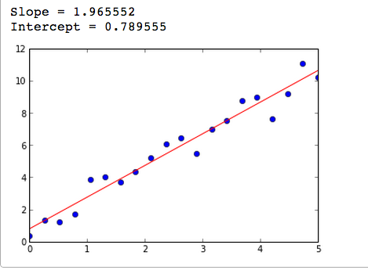

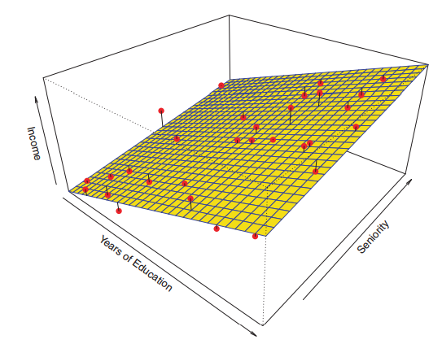
Linear Regression
Key terms:
Features
Target variables
Coefficients
Slope
Intercept
Loss function
Model fit

Slide 3
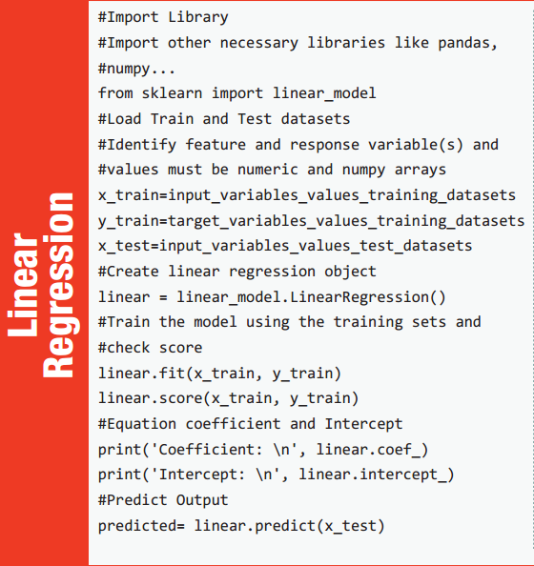
Notes:
https://www.analyticsvidhya.com/wp-content/uploads/2016/08/MLalgorithms-.pdf

Slide 4
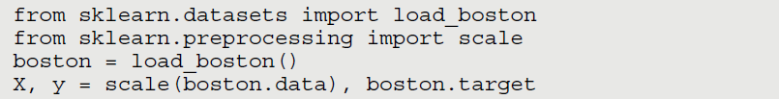
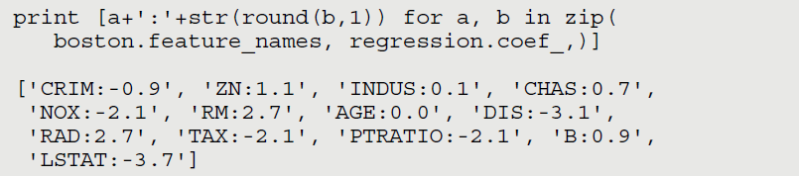
Scikit Learn Code

Slide 5
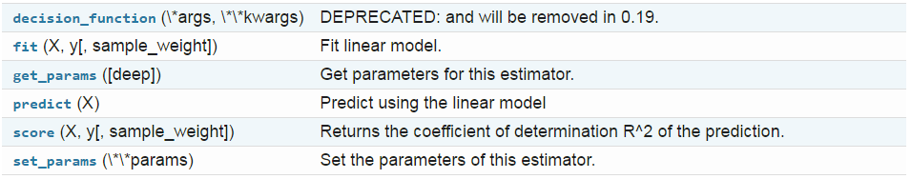
Methods

Slide 6
Analysis of Residuals
A histogram / QQ-plot of the residuals - check the normality assumption
Plot of residuals against fitted values or the independent variable - check the assumption of constant variance and the aptness of the model.
Plot of residuals over time if the data are chronological
Regression is robust against moderate lack of Normality
Outliers and influential observations can invalidate the results of inference for regression

Slide 7
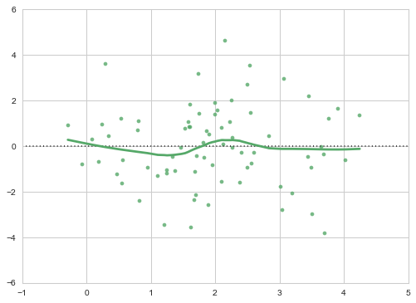
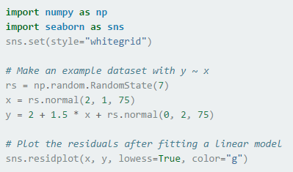
residplot - Residuals
Useful in studying whether a regression model is appropriate for the data

Slide 8
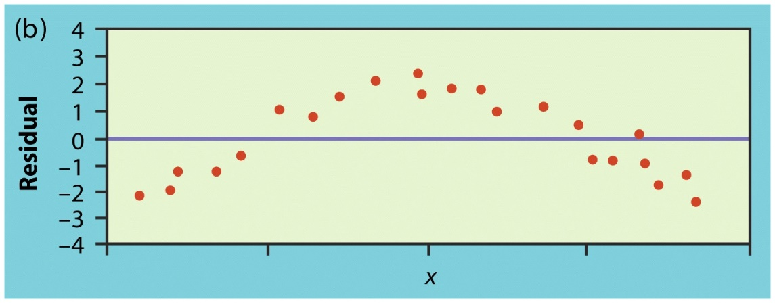
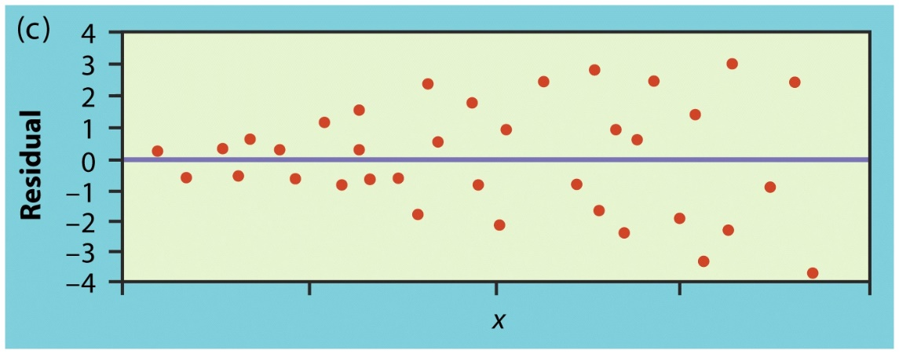
Residuals Plots
Non linear relationship
Larger spread for larger X

Slide 9
Variable transformations
Transformations can stabilize the variance
Transformations can turn non-linear relationships into approximately linear
Common linearizing transformations are:
Variance stabilizing transformations are:

Slide 10
Interpretability
The variables with the largest magnitude have the highest correlation with the output
A large positive coefficient implies that the output will increase when this input is increased (positively correlated)
A large negative coefficient implies that the output will decrease when this input is increased (negatively correlated)
A small or 0 coefficient suggests that the input is uncorrelated with the output (at least at the 1st order)
Linear regression can be used to find best "indicators"
Remember - Correlation doesn’t imply causation!
Do ice cream sales lead to more drowning events?
Big problem with big data – when having many variables
Notes:
Dependent (output) variable rain. Independent (input) variable: Clouds, umbrella open, etc. Open-Umbrella is correlate, not causal.

Slide 11
Regression Evaluation Measures
callable string function
mean_absolute_error sklearn.metrics.mean_absolute_error
mean_squared_error sklearn.metrics.mean_squared_error
r2 sklearn.metrics.r2_score

Slide 12
Limitations
Can only model numeric data
Doesn’t handle missing values well
Sensitive to outliers
Assumes linear relationships
Assumes errors are distributed normally with constant variance (if not, apply transformations)
Doesn’t handle collinearity well

Slide 13
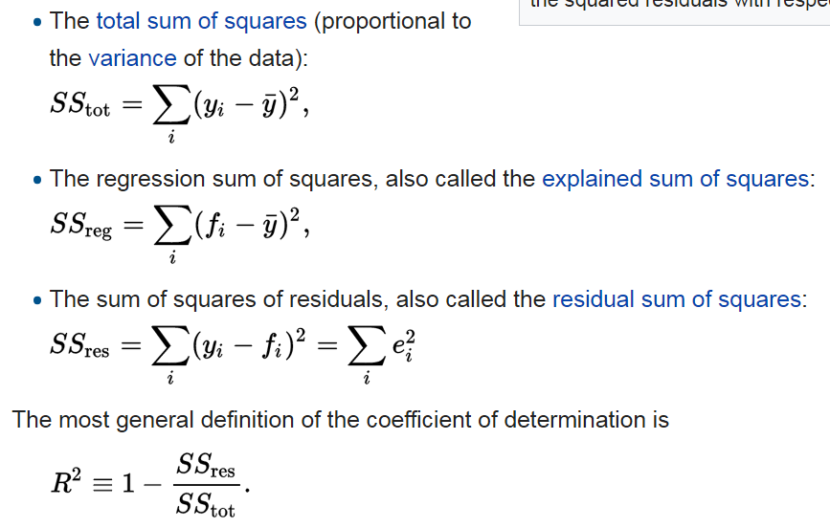
R²

Slide 14

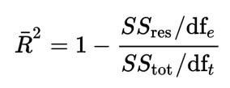
Adjusted R²
In least squares regression, R2 is weakly increasing with increases in the number of regressors in the model.
The adjusted R² corrects for this by considering the number of variables used:

Slide 15



Covariance
Variance is a special case of the covariance

Slide 16
Correlation coefficient
Pearson’s Correlation Coefficient is standardized covariance (unitless):
In correlation, the two variables are treated as equals. In regression, one variable is considered independent (=predictor) variable (X) and the other the dependent (=outcome) variable Y.

Slide 17
Correlation (PEARSON)
Measures the relative strength of the linear relationship between two variables
Unitless
Range:
–1 : strong negative linear relationship
0 : no linear relationship
1 : strong positive linear relationship
Spearman correlation is a non-parametric measure that uses values rank

Slide 18
Resulting formulas…
Slope (beta coefficient) =
Intercept=
Regression line always goes through the point:

